Slide 1

Apple stock Forecast
Team 4

Slide 2
Team members
MENTOR’S NAME : ABIRAMI
TEAM MEMBERS:
Mr. Prasanth G
Mr. Chaitanya
Ms. Gaganasindhu Y Hadagali
Mr. Prajwal Ambure
Mr. Hari Prasath P
Mr. Rahul Kumar Dubey
Ms. Akanksha Bhalerao

Slide 3
Business Objective
Help the Investors, traders, and financial analysts monitor stock prices to make buy/sell decisions. Predict the apple stock market price for the next 30 days. The dataset contains financial, economic, and sentiment-related variables that influence Apple's stock price. Below is a breakdown of each variable, its meaning, and real-world impact on financial markets.

Slide 4
DATASET DETAILS
The dataset used in this project consists of historical daily Apple stock price records collected over a defined time period from the financial market.
Each data entry corresponds to a specific trading day, ensuring that the dataset follows a strict chronological order, which is essential for time-series analysis.
Each data entry corresponds to a specific trading day, ensuring that the dataset follows a strict chronological order, which is essential for time-series analysis.
Each data entry corresponds to a specific trading day, ensuring that the dataset follows a strict chronological order, which is essential for time-series analysis.
Since the data reflects real-world market conditions, it is well-suited for training a SARIMA time-series forecasting model.

Slide 5
Project architecture
Data Collection
Business Understanding
Exploratory Data Analysis(EDA)
Deployment
Model Building

Slide 6
EDA OVERVIEW
Exploratory Data Analysis (EDA) is a crucial step in understanding the structure and behavior of historical Apple stock price data before applying forecasting models.
This phase focuses on analyzing data distribution, identifying trends, and detecting patterns over time.
EDA helps verify data quality and ensures that the dataset is suitable for time-series forecasting.
Through visual and statistical analysis, important insights about stock price movement are obtained.

Slide 7
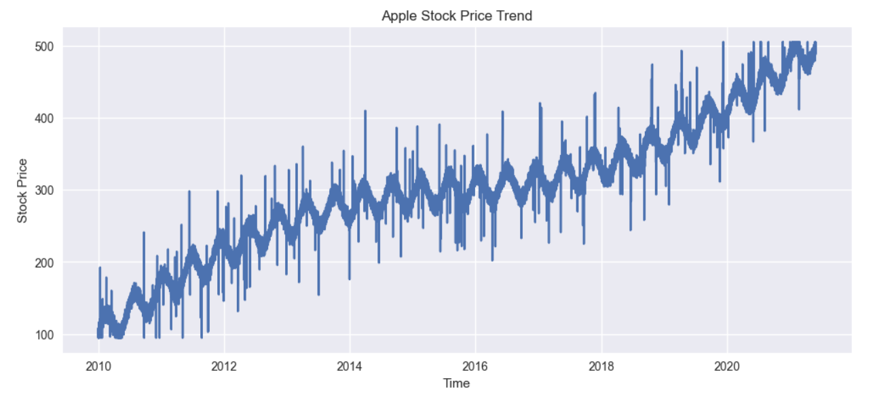
Time-Series Visualization Analysis
In this step, the historical Apple stock prices are visualized using time-series line plots.
The visualization clearly shows how stock prices fluctuate over different time periods.
Sudden rises, falls, and stable phases can be easily identified through this graphical representation.
Time-series visualization helps in understanding the overall direction and volatility of stock prices.

Slide 8
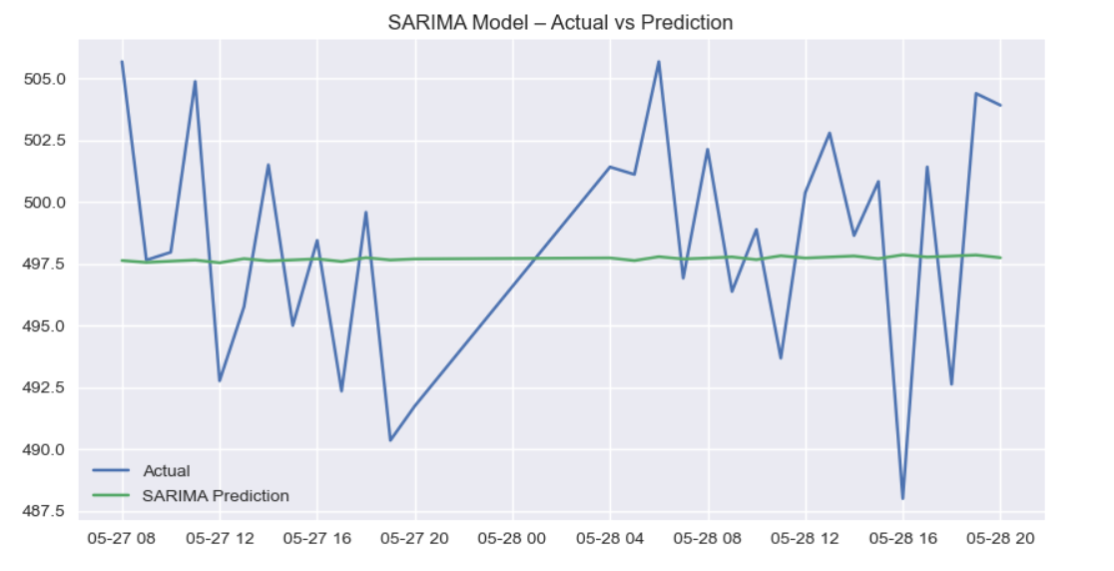
Stock Price Movement Analysis
By observing the line plot, fluctuations in Apple stock prices can be clearly seen.
These fluctuations reflect real market behavior influenced by external and internal factors.
This analysis confirms that the data contains meaningful patterns for forecasting.

Slide 9
Pattern Observation in Data
The time-series visualization reveals repeating movements and variations in stock prices over time.
Observing such patterns is important for selecting an appropriate forecasting model. This observation supports the use of SARIMA for prediction.
Exploratory Data Analysis confirms that the dataset is well-structured, consistent, and free from missing values.
These characteristics make the dataset suitable for time-series forecasting.
Based on EDA results, the data is ready for SARIMA model building and forecasting.

Slide 10
MODEL BUILDING OVERVIEW
In the model building phase, multiple forecasting models were explored and trained using historical Apple stock price data to identify the most suitable approach.
Both statistical time-series models and machine learning models were considered for comparison.
The goal of this phase was to evaluate different models based on their ability to capture time-dependent patterns and generate reliable forecasts.
This comparative approach ensures that the final selected model provides the best forecasting performance.

Slide 11
Models Considered for Forecasting
Several forecasting models were trained during this project, including ARIMA, SARIMA, VAR, and Random Forest.
ARIMA was used to capture basic autoregressive and moving average patterns in the time-series data.
VAR was explored to understand multivariate relationships in time-dependent data.
Random Forest was applied as a machine learning approach to analyze non-linear patterns.
Each model was trained on the same historical dataset to ensure fair comparison.

Slide 12
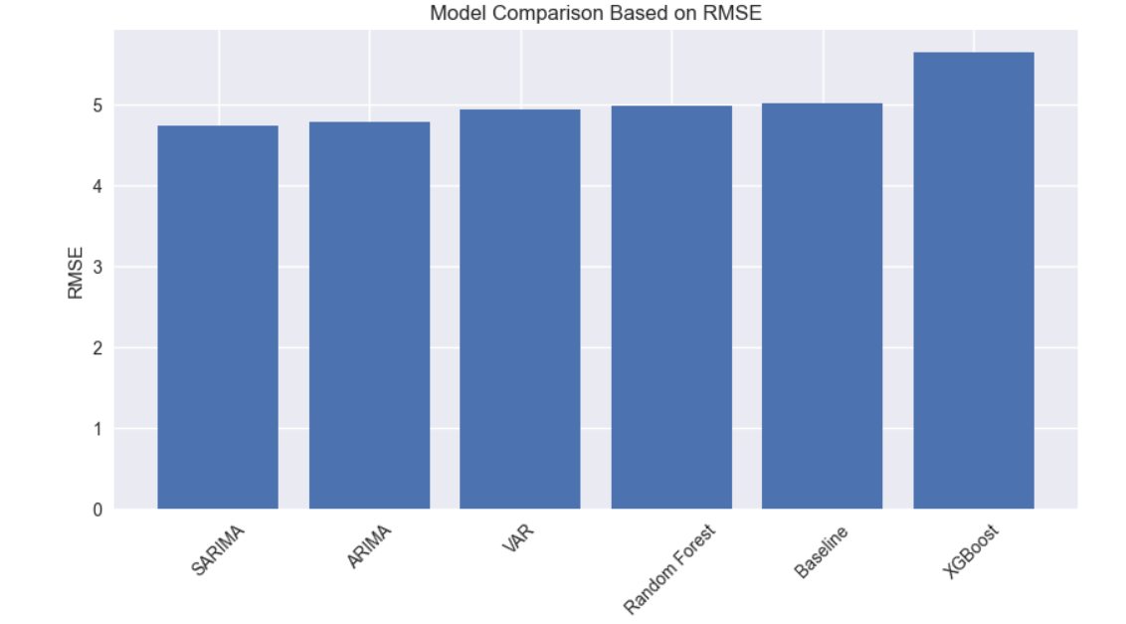
MODEL EVALUATION and Comparison
After training, the models were evaluated based on forecasting accuracy, stability, and suitability for time-series data. ARIMA captured trends but lacked seasonal handling.
VAR required multiple correlated variables and was less effective for single-stock forecasting. Random Forest performed reasonably but did not naturally handle time dependency without extensive feature engineering.
These observations highlighted the need for a model that could effectively manage seasonality and temporal patterns.

Slide 13
Final Model Selection – SARIMA
SARIMA was selected as the final model because it effectively handles both trend and seasonal components in time-series data.
It provided more stable and realistic forecasts compared to other models.
SARIMA also required fewer external features and aligned well with the univariate nature of stock price data.
Due to its reliability and forecasting performance, SARIMA was chosen for deployment.

Slide 14
DEPLOYMENT OVERVIEW
Deployment is the final stage of the project where the trained SARIMA forecasting model is integrated into a user-accessible application.
The purpose of deployment is to convert the developed model into a practical system that can generate real-time stock price forecasts.
This phase ensures that the forecasting solution can be used by non-technical users without requiring knowledge of data science or programming.

Slide 15
Application interface
The deployment architecture follows a simple and effective design where the trained SARIMA model is connected to a web-based application.
Historical stock price data and the trained model are stored on the backend.
When a user interacts with the application, the system loads the saved model and generates forecasts for the next 30 days.
The results are then processed and displayed to the user in both tabular and graphical formats. This architecture ensures fast response time and avoids repeated model training.

Slide 16
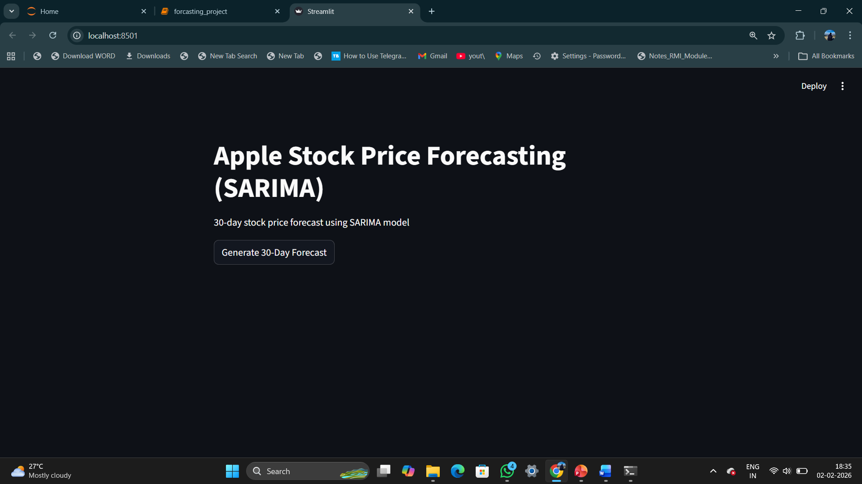
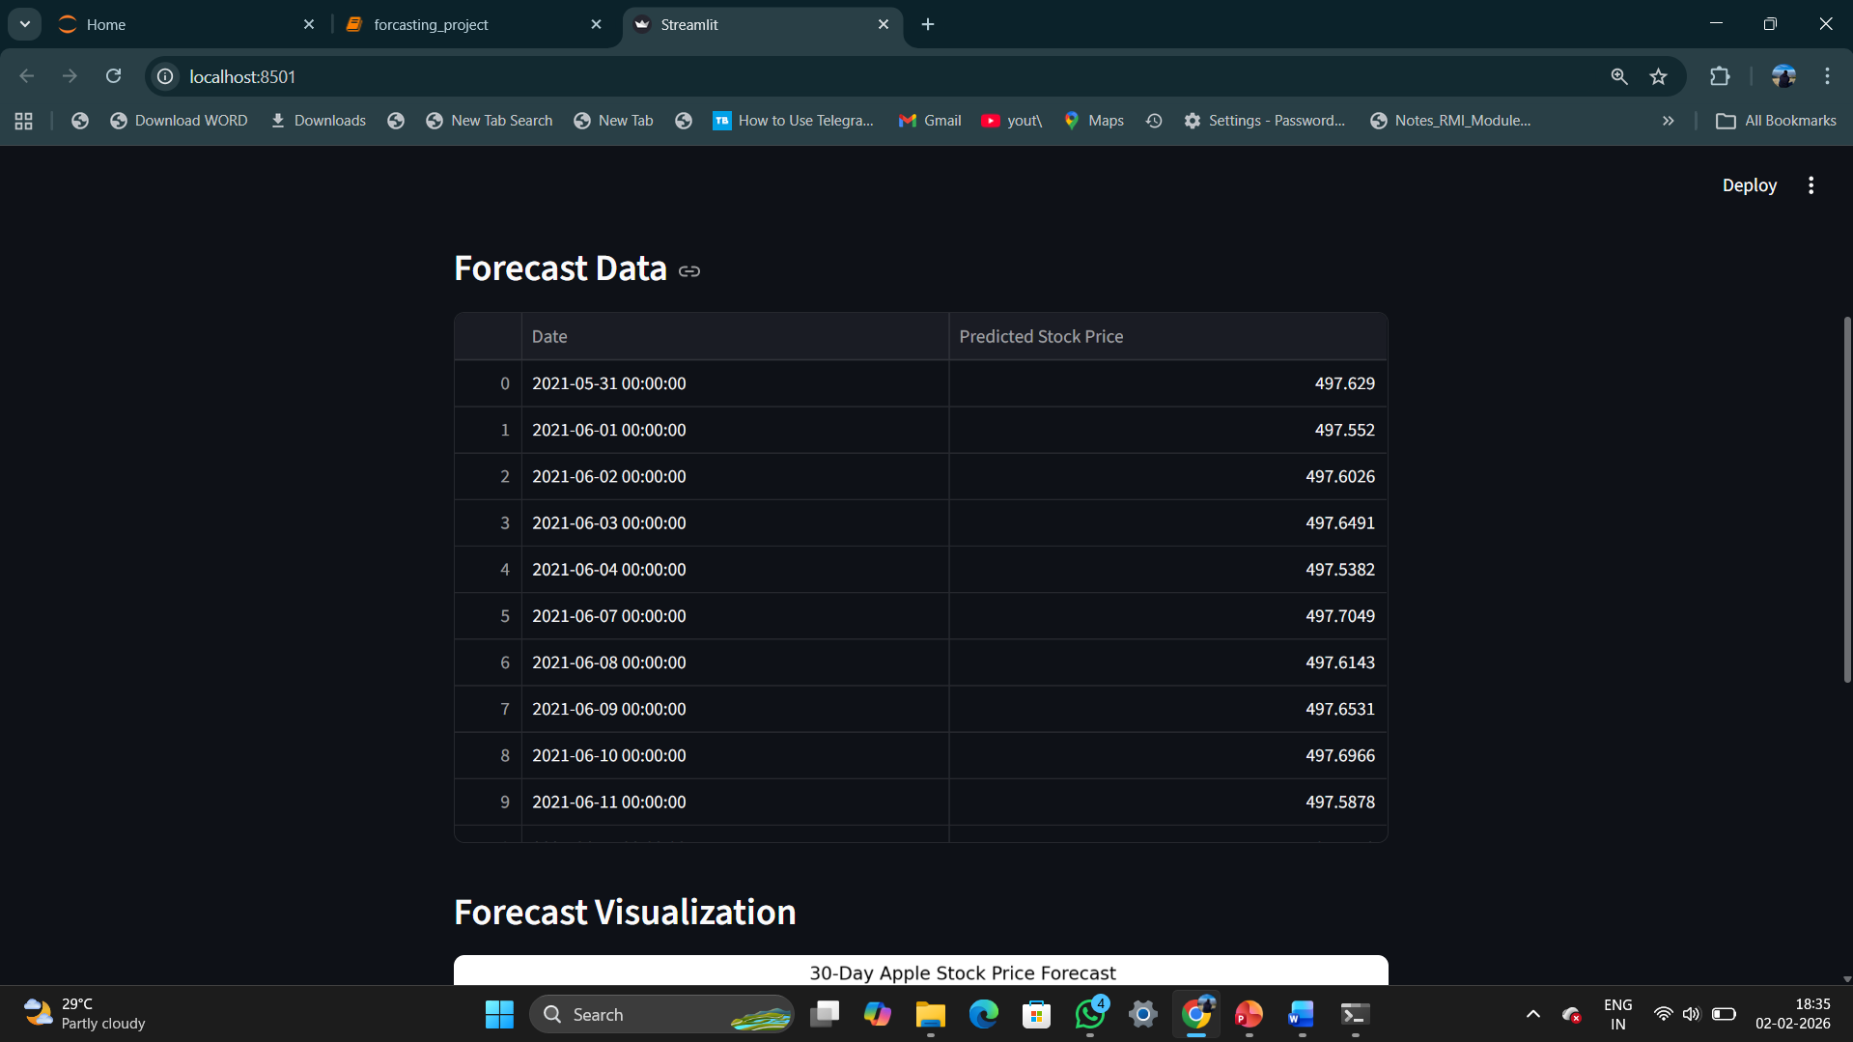
Application interface

Slide 17
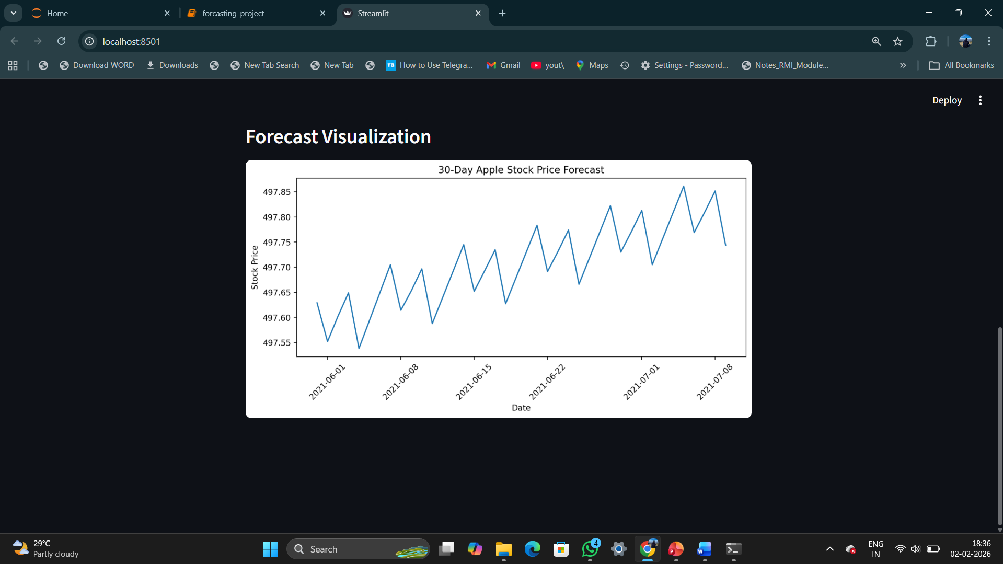
APPLICATION INTERFACE

Slide 18
CHALLENGES FACED DURING THE PROJECT
Handling time-series stock price data while maintaining correct chronological order.
Understanding trend and seasonal behavior present in financial data.
Comparing multiple models and selecting the most suitable one.
Tuning SARIMA parameters to improve forecasting accuracy.
Generating future business-day dates for realistic predictions.
Deploying the trained model into a simple and user-friendly application.

Slide 19


